Slide 1
Parallel Programming

Slide 2
Introduction
What is a parallel program?
Multiprogramming vs. Multitasking vs. Multiprocessing
Coarse grained parallel processing
Fine grained parallel processing
Symmetric parallel processing
Asymmetric parallel processing
H/W support
Software support

Slide 3
Creating a Child Process
int main()
{
int id;
id=fork();
printf(“Hello %d\n”, id);
}
System call fork() and its return value
Who is parent & who is child?
Variable Scenario

Slide 4
Creating Two Child Processes
int main()
{
int id;
id=fork();
Id=fork();
printf(“Hello %d\n”,id);
}
Will the above code work as intended?

Slide 5
process_fork()
int main()
{
int id; id=process_fork(3); printf(“Hello %d\n”,id);
}
int process_fork(int n)
{
int i;
for (i=1; i<n; i++)
{
if(fork()==0) {return i;}
}
return 0;
}

Slide 6
If a Small Change???
int main()
{
int id; id=process_fork(3); printf(“Hello %d\n”,id);
}
int process_fork(int n)
{
int i;
for (i=1; i<n; i++)
{
if(fork()==0) {return i;}
else {return 0;}
}
}

Slide 7
process_join()
int main()
{
int id; id=process_fork(3); printf(“Hello %d\n”,id); process_join(id,3);
}
void process_join(int id, int n)
{
int i;
if (id==0)
{
for(i=1;i<n;i++) { wait(0);}
}
else
{
exit(0);
}
}

Slide 8
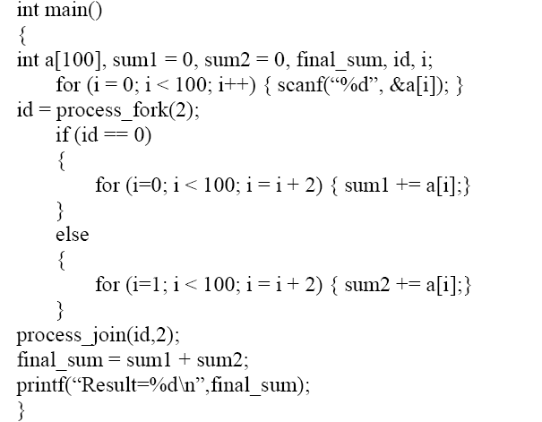
Array Sum – Right Output???

Slide 9
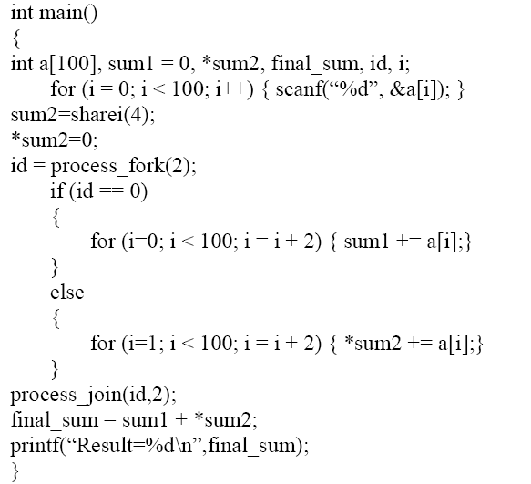
Array Sum

Slide 10
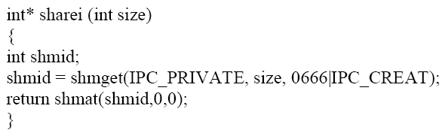
Sharing a Variable

Slide 11
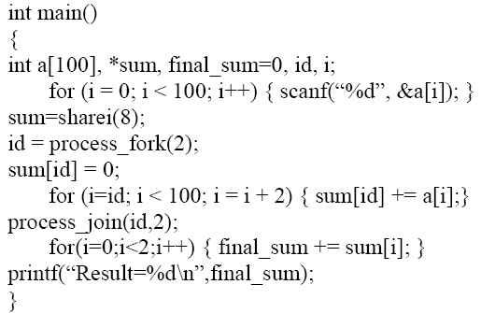
Loop Splitting

Slide 12
Contention
int main()
{
int id, *i;
i = sharei(4);
*i = 5;
id = process_fork(2);
*i = *i + 1;
printf(“id = %d i = %d\n”, id, *i);
process_join(id,2);
}

Slide 13
Solving Contention Problem
int main()
{
int id, *i, *lock_word;
i = sharei(4);
lock_word = sharei(4);
*i = 5;
init_lock (lock_word,0);
id = process_fork(2);
lock (lock_word);
*i = *i + 1;
unlock (lock_word);
printf(“id = %d i = %d\n”, id, *i);
process_join(id,2);
}

Slide 14
init_lock()
void init_lock(int *lock_word, int val)
{
*lock_word = semget (IPC_PRIVATE, 1, 0666 | IPC_CREAT);
if (value == 0)
{
semctl(*lock_word, 0, SETVAL, 1);
}
else
{
semctl(*lock_word, 0, SETVAL, 0);
}
}

Slide 15
lock()
struct sembuf
{
short flag;
short op;
short num;
};
void lock(int *lock_word)
{
struct sembuf operations;
operations.flag=0;
operations.op=-1;
operations.num=0;
semop (*lock_word, &operations, 1);
}

Slide 16
unlock()
struct sembuf
{
short flag;
short op;
short num;
};
void unlock(int *lock_word)
{
struct sembuf operations;
operations.flag=0;
operations.op=1;
operations.num=0;
semop (*lock_word, &operations, 1);
}

Slide 17
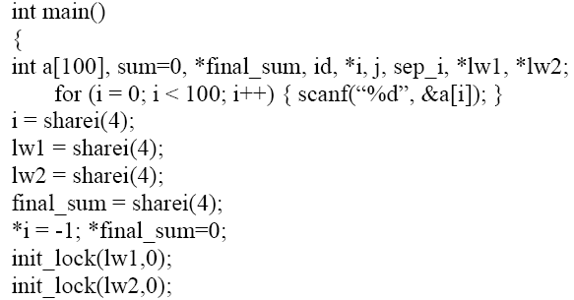
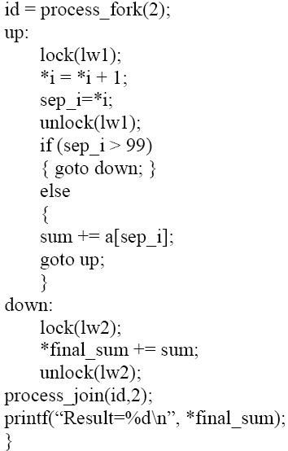
Array Sum Using Self Scheduling

Slide 18
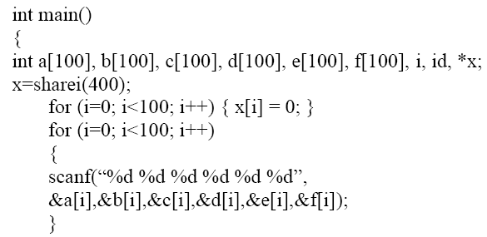
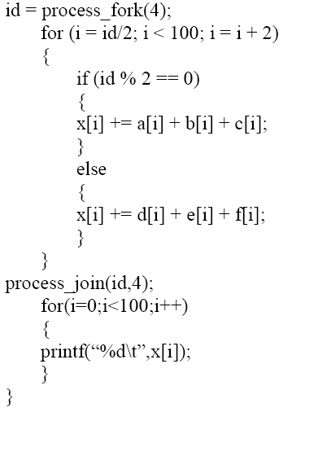
Expression Splitting – Right Output???

Slide 19
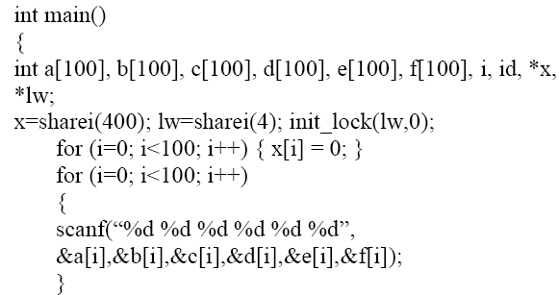
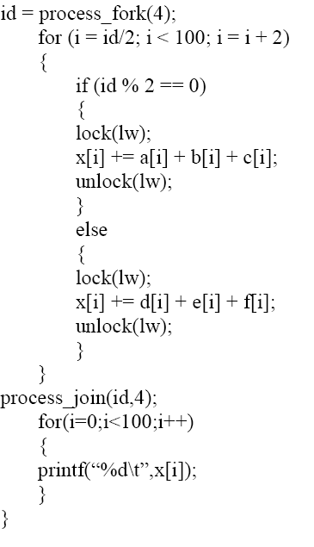
Expression Splitting Using Single S.L.

Slide 20
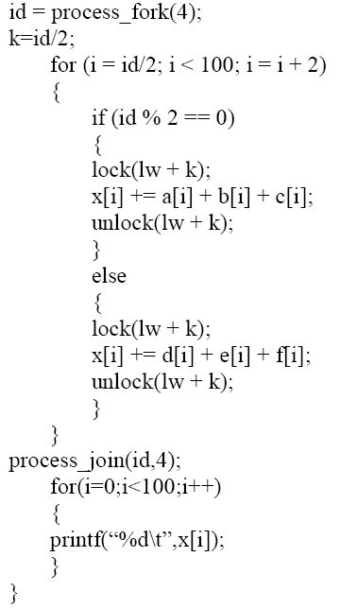
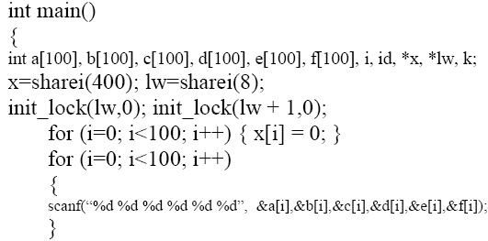
Expression Splitting Using Single M.S.L.

Slide 21
Further Reading
Barrier
Data Dependency

